Slide 1

WEBD2075
Web Security

Slide 2
Who am I?
Russell Munday
25 years in the IT industry
More than 12 years instructing in the classroom, both civilian and military
Certifications going all the way back to Windows NT 4.0
Worked in Canada, UK, and the US

Slide 3
Policies
Link to policies: https://www.nscc.ca/about/publications/index.asp
Respectful Workplace and Learning Environment
Student Community Standards Policy
Sexual Violence
Drug and Alcohol
Academic Integrity
Academic Accommodations
Educational Equity

Slide 4
What can you expect of me?
Resource to aid in your learning - Not here to give you answers
Hard work
Focus on learning
Emphasis on practical knowledge and skills
Open to feedback and constructive criticism - Don’t just criticize, offer suggestions

Slide 5
What do I expect of you?
Abide by policies
Encourage and support each other
Try! - Communicate with me if you are struggling

Slide 6
Contact
Phone number: I don’t have one ☺
Email: russell.munday@nscc.ca
Resource, use me!
Email: include the course name in the subject
Official Response Expectations: best effort in 48 hours (not including weekends/holidays)
Unofficial Response Expectations: will get back to you ASAP
Reasons to contact: - Missing class - Unable to meet deadlines - Questions, concerns

Slide 7
Contact
Example: Bad Email “Hi Russell. I have a problem with my virtual machine. Please help.”
“Dude! My clicky-box is having a problem. Should I do something?”
Example: Good Email “Hi Russell. I have a problem with my virtual machine where it will no longer load into the operating system. It last worked yesterday. Screenshot of error message is attached. I have attempted the following things to troubleshoot the issue <description of attempts>… Please help.”

Slide 8
Contact
Services available: - Food bank - Financial aid - Emergency accommodation - Counselling - Learning supports - Writing center

Slide 9
Brightspace
Brightspace: https://nscconline.brightspace.com/
Brightspace Guide: https://d2ltoolkit.nscc.ca/
What is on Brightspace?
Class resources
Communications (discussion boards, announcements)
All materials used in lessons (PowerPoint slides, handouts)
Assignments
Grades
Deadlines
Much more…

Slide 10
Brightspace
Expectations
Regularly checking Brightspace for updated material
Notifications
Submitting required assignment work through Brightspace
Pulse App
App for iOS/Android
Notifications to your phone

Slide 11
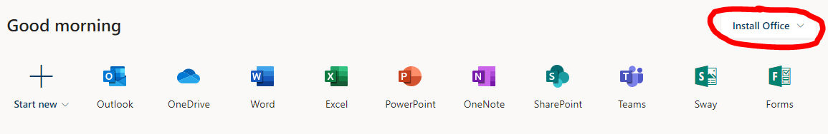
Office 365 & OneNote
Office 365 login: https://www.office.com/
Username: w1234567@campus.nscc.ca
Password: your NSCC password
Install Office
OneNote
If you don’t have a system for taking notes, try OneNote!

Slide 12




Other useful applications
Notepad++
ShareX
Cisco PacketTracer
MobaXterm
Gimp
Generative AI Copilot/Chat-GPT/Gemini

Slide 13
Classroom Environment
School vs Industry
Missed classes
Check Brightspace for any content shared during class
Ask myself or classmates to fill you in
Equity vs Equality
Diversity & Inclusion
Content delivery
Attendance in this course is critical!
Evaluations can only be performed in class
To be clear: if you consistently do not attend classes, there will be NO exceptions made and you WILL fail the course.

Slide 14
Pilot Program - Grading
Grading for each skill evaluation works in the same manner:
60% (passing grade) = Successfully performed the hands-on work to the required criteria
85% (honours grade*) = Successfully answered questions asked during the evaluation class with general answers that demonstrate their knowledge but lack the key details
100% (full marks) = Successfully answered questions asked during the evaluation class with specific answers that consistently reference key details of the steps performed
The catch here is that if you are unable to meet the criteria for 60%, you will receive a 0% for that evaluation. DO NOT BE CONCERNED! Each module gives you three opportunities to perform the evaluation. After each attempt you will be provided with feedback to help you address where you didn’t meet the criteria.

Slide 15
Net 172
Net172 Labs:
D209
D210
D313
D315
D316 (Student Data Center)
D317
Warning signs on door
DON’T do anything private/confidential on computers in those labs
Use a virtual machine instead

Slide 16
Questions?

